Slide 1
The Noise User orientated audio streaming program
Team Members:
Tom Bloom
Matthew Lindsay
Jeffrey Price

Slide 2
What’s The Noise
User Login
Registration for New User
Setup for IP Address
Audio file display and information
Select file and play
Notes:
These are the feature I can think of feel free to add. Plan to have a slide for each

Slide 3
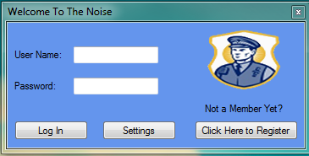
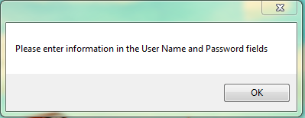
User Log In
Error Message
Notes:
The log in window and error that can occur

Slide 4
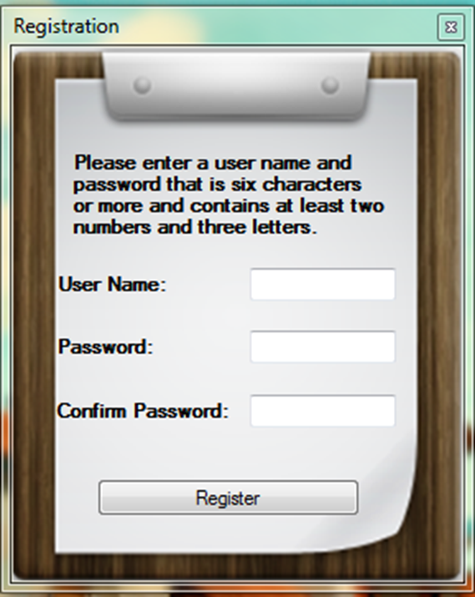
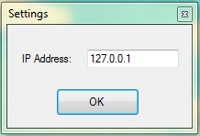
Setting and Registration Window
Enter a IP Address
Notes:
Window to enter IP address

Slide 5
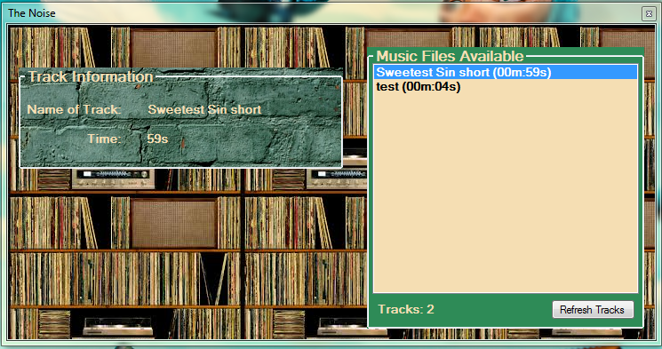
Audio Player Window
Notes:
Talk about the window and the requrments need to

Slide 6
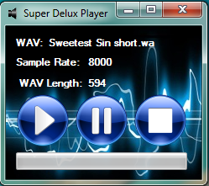
Derek’s Music Maker
Notes:
Show the display of what the window looks like with information of slides and the window when the music is playing.

Slide 7
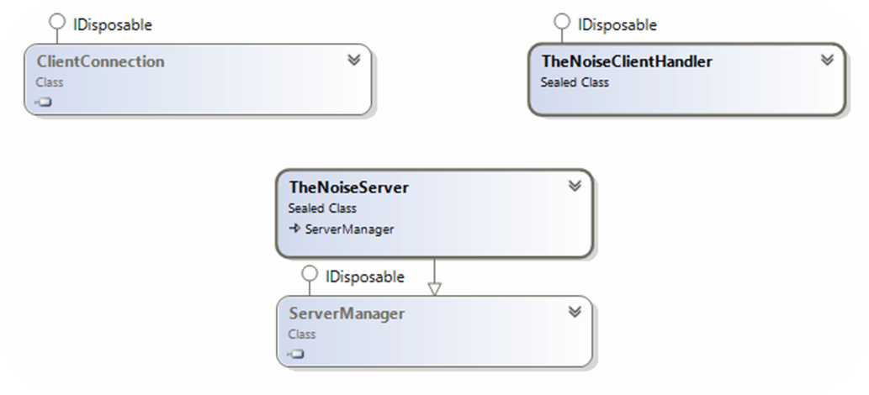
The Server

Slide 8
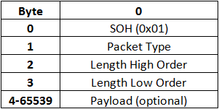
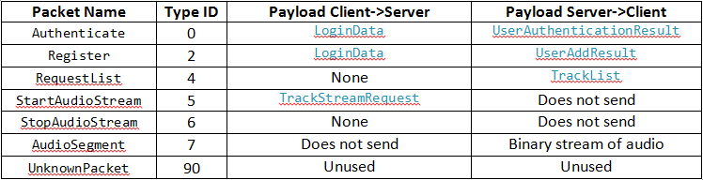
Client/Server Protocol
Low Level Packet
High Level Packet

Slide 9
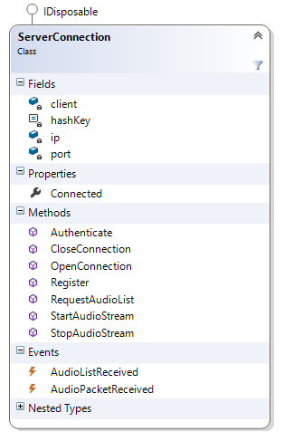
Server API
Maintains connection to server
Handles Registration and Auth
Hashes passwords before sending
Provides updates of audio listing

Slide 10
Database Access Layer
Makes things silky smooth for the server
Two functions for the server to call, validateUser and addUser.
These functions return the enumeration UserAuthenticationResult and UserAddResult so the server knows exactly what to do with the result.
Contains three tables: musicUsers, directories, and userDirectories.
Utilizes two procedures: checkMusicUser and addMusicUser
Procedures make things safe and easy

